Slide 1
Systems analysis: requirements determination phase
Introducing organizational charts and dataflow diagrams and what they can help us learn about new systems

Slide 2
Let's review the venn diagram
What if we could map out the entire business environment in one diagram?
Would this frame the problem better for us ?
Would this help us break the problem into several pieces?
What did you learn about your project while doing a venn diagram? Come up with one solid observation, and be ready to detail this in your first paper

Slide 3
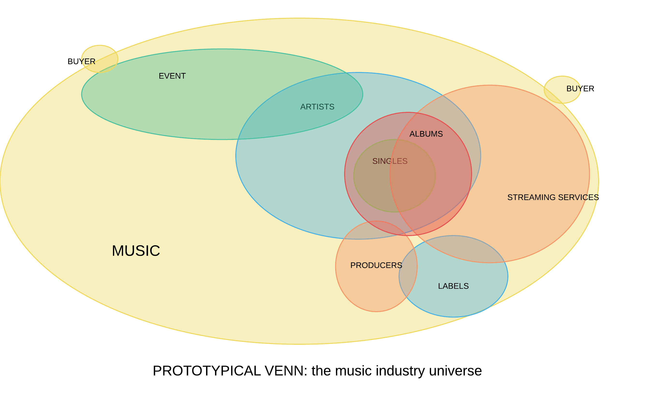

Slide 4
Basic rules to venn
Everything is a data set, everything is made of numbers and words
Circles which touch represent things which touch
When you have intersecting circles, you have intersecting data, that is related or joined
Purpose: where is there useful data in the situation you’re facing

Slide 5
Let's review The pestle analysis
Once you have done the venn diagram, don't you feel that you have a better grasp on the bigger macroeconomic picture, especially as it intersects the culture of the marketplace as well as the regulatory and environmental dimensions?
Since any one of these vectors could determine the success of the project, isn't it difficult to conceive of them in one place?
The purpose of this diagramming technique is to align them in one place so you can predict the outcomes of your ideas

Slide 6
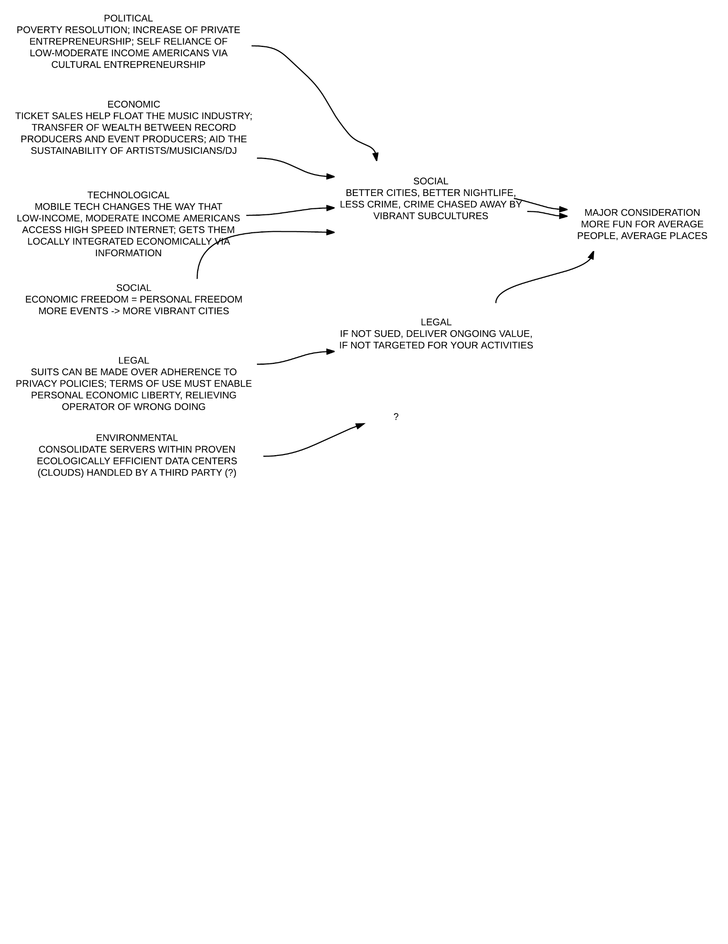

Slide 7
Let me review the concept of value stream analysis and market signaling
Value stream analysis helps us understand the business as a continuous flow of materials being transformed into valuable things
Once this value stream analysis, or VSA is created, traditional businesses consider the impact of kanban
Kanban describes the preferences of the customer, which impact demand.
For businesses which must manufacture, produce or pay for things before they produce earnings, kanban helps them make a forecast for what they must make
What was one major observation which your team made when constructing the value stream and kanban analysis?
Be sure to detail this finding in your first report

Slide 8
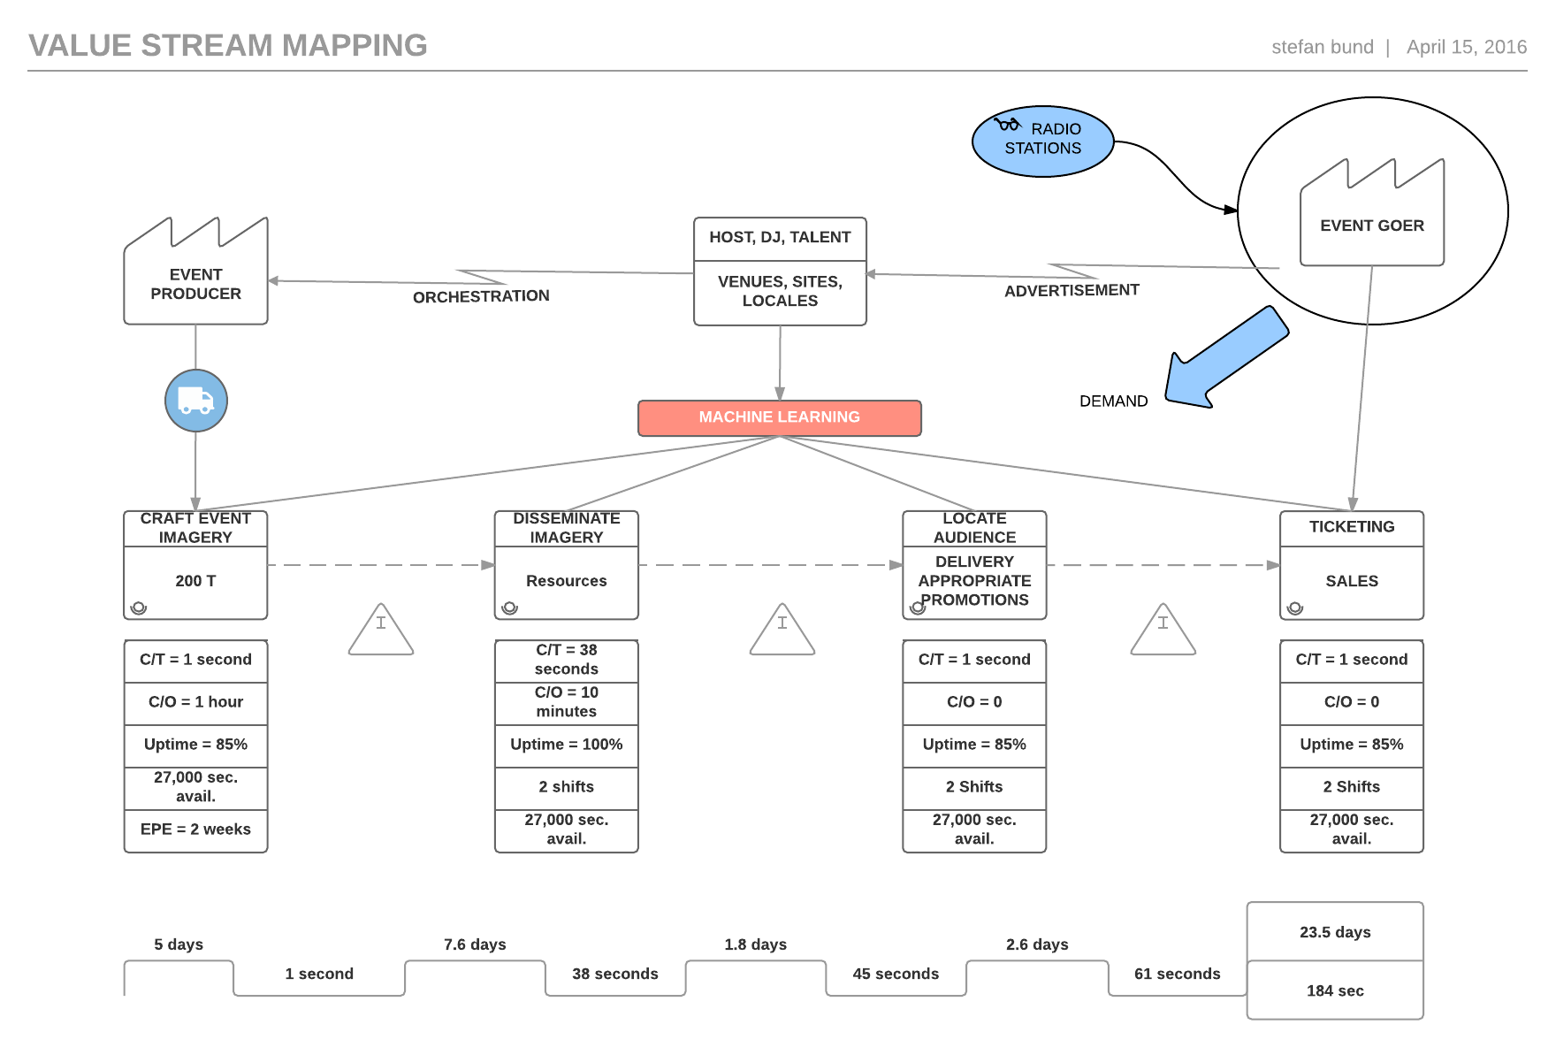

Slide 9
Now let's talk about something new:
organization charts
Most organizations construct these to clarify the duties of each employee
Each employee reports on their outcomes two managers, thus producing a flow of information between role players
For information systems designers, this creates a wonderful opportunity to discuss who knows what and when

Slide 10
And another new concept: the data flow diagram
Classical systems analysis creates a diagram which captures the flow of information between things in a real-world situation.
Since industrial automation and organizational productivity depends upon in an enhanced flow of information, the data flow diagram is used to do this
How would you contrast the van diagram with the data flow diagram?

Slide 11
What happens when we mix and organizational chart with a DFD?
As you may have guessed, we can productively map the flow of information between different kinds of employees in a value stream

Slide 12
Assembling an organizational data flow diagram

Slide 13
Interesting thought
Do businesses know when they have a problem?
If you believe yes, do they know exactly what they need to do to improve?
What about in the situation of a start up at a place like Cal Poly? Students are smart enough to identify real human needs, but do they know what system to make?

Slide 14
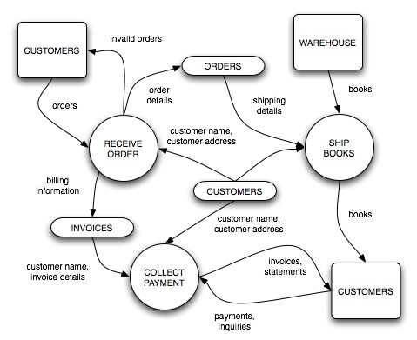
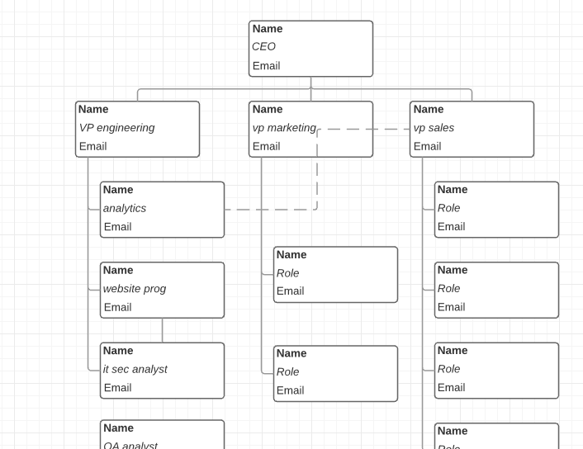
Ok take a break, then
Begin to form organizational charts and DFDs for your co

